Slide 1
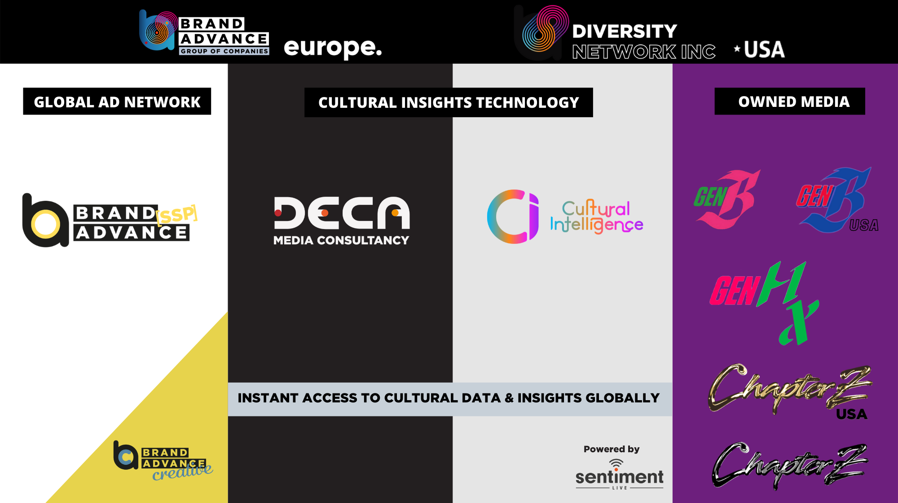


Slide 2
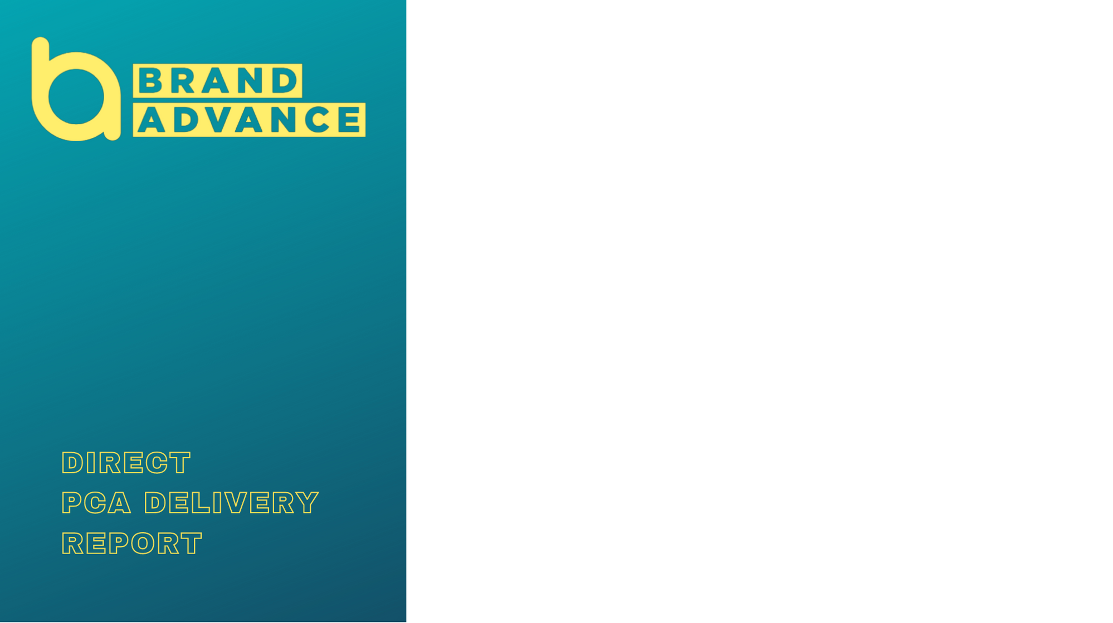

DIGITAL DISPLAY & VIDEO
OBJECTIVE: GSK wanted to showcase their new Advil: You are Stronger campaign across the LGBTQ+ community as well as all other communities.
KPI: CTR 0.20% | VTR 60.00%
FORMATS: Video In Slide, In Content and Pre-Roll. Display Standard IAB. Rich Media DisplayView
PARTNERS: Brand Advance DIVERSITY NETWORK.
TARGETING:LGBTQ+ and all other communities
GEOTARGETING: Brazil
TIMINGS: 23rd Sept - 31st Dec 2021
DELIVERED SPEND: £50,363.01
CREATIVE BUDGET: £30,000

Slide 3
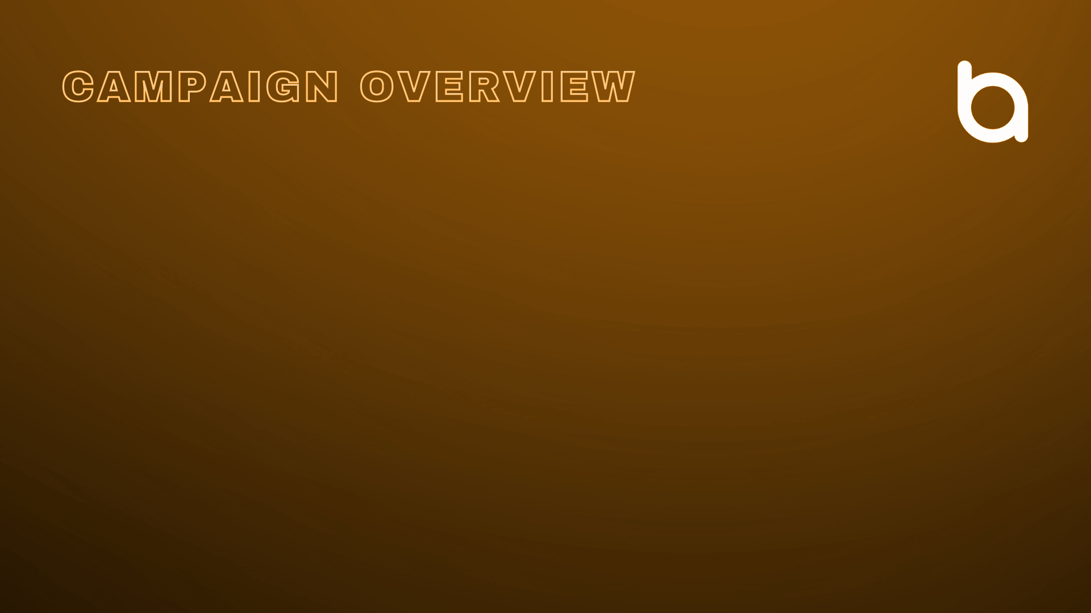
CAMPAIGN: Advil: You are Stronger
DATES: 23rd September to 31st December 2021.
Campaign Overview - Video, Display & Rich Media
Metric | Impressions | CTR | VTR | Media Spend
Display Total Planned | 2,550,000 | 0.20% | N/A | £25,500.00
Display Total Delivered | 2,568,471 | 0.23% | N/A | £25,684.71
Rich Media Total Planned | 444,444 | 0.35% | N/A | £8,000.00
Rich Media Total Delivered | 445,532 | 0.51% | N/A | £8,019.58
Video Total Planned | 660,000 | 0.50% | 65.00% | £16,500.00
Video Total Delivered | 666,349 | 0.88% | 65.64% | £16,658.72

Slide 4
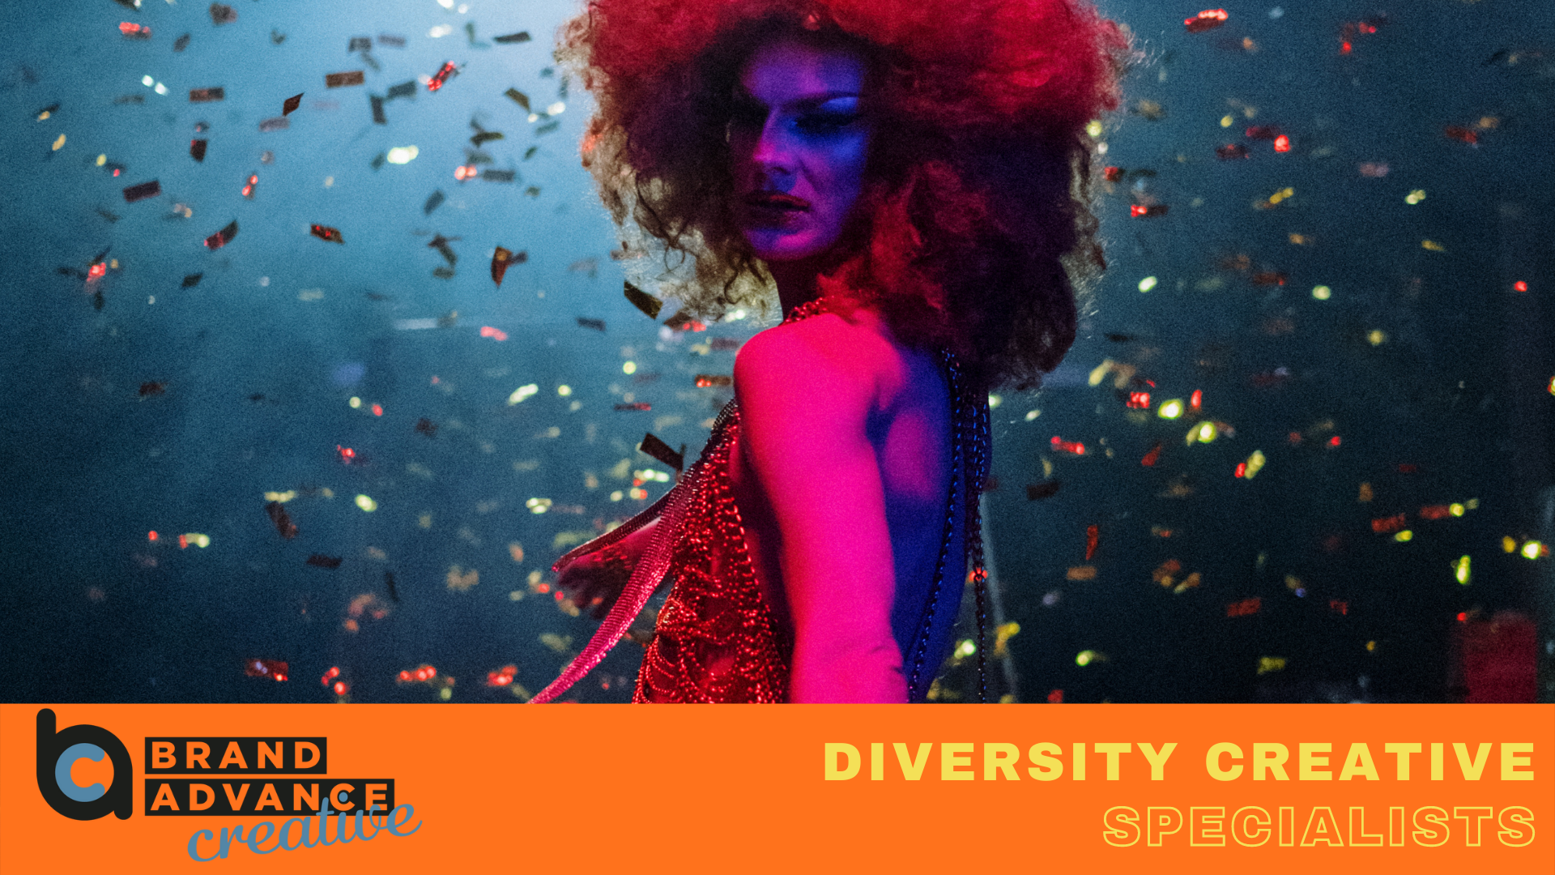

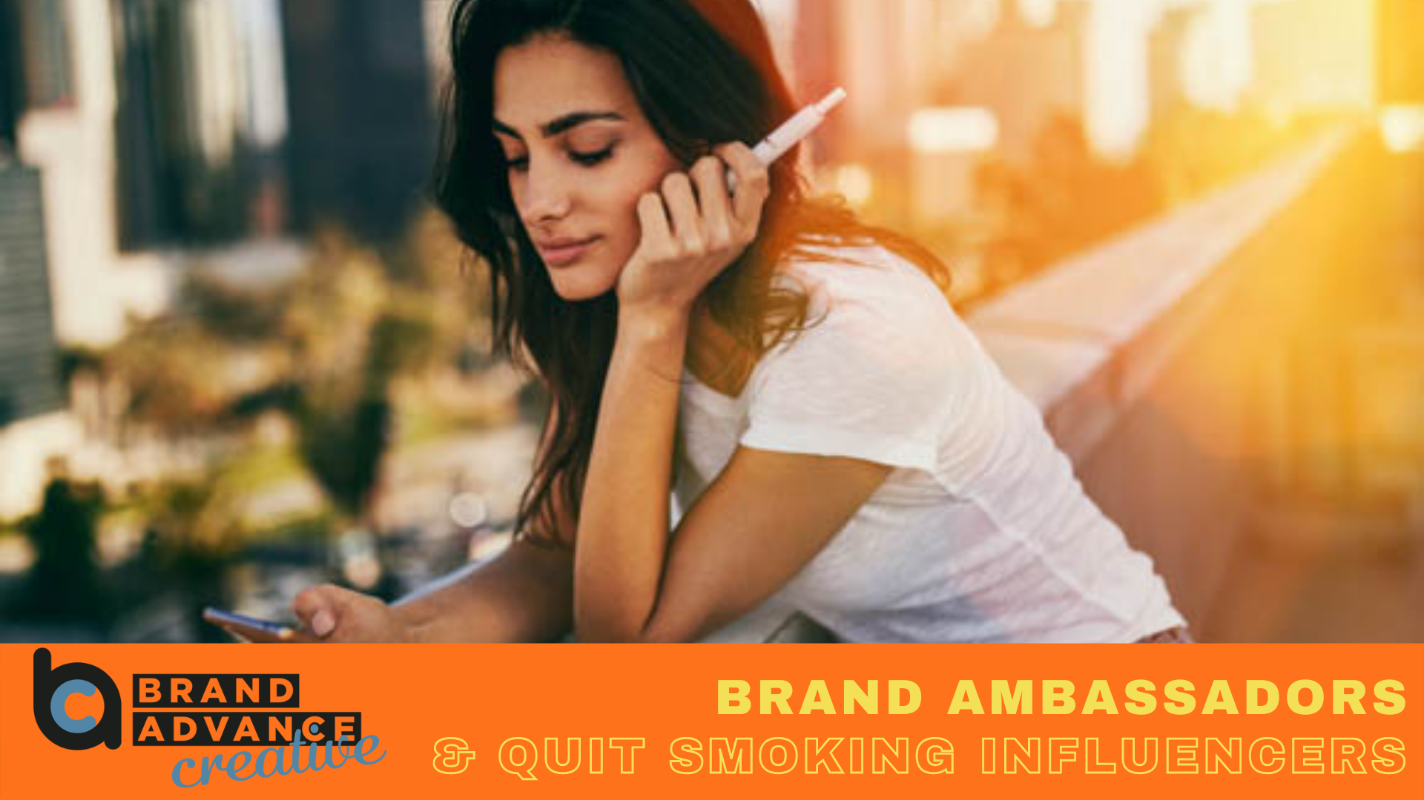
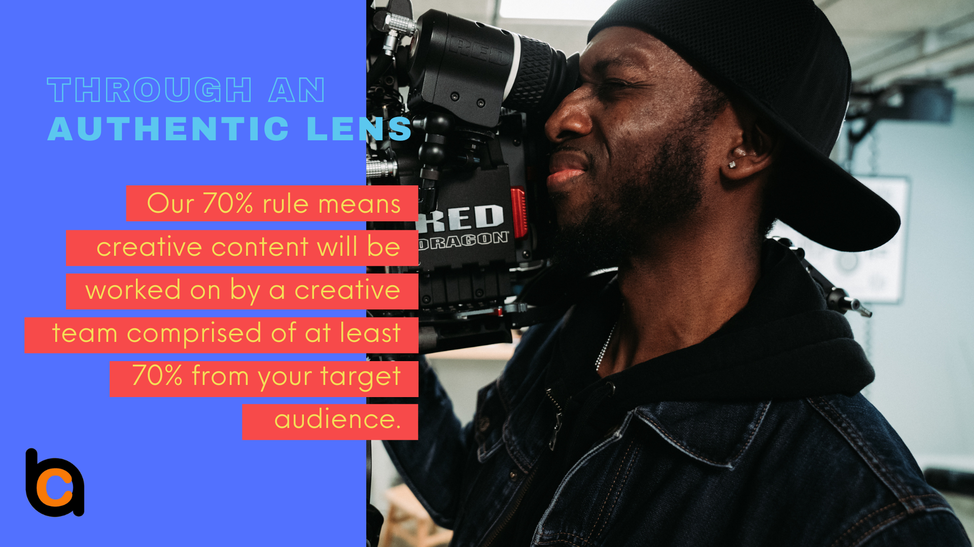

Slide 5
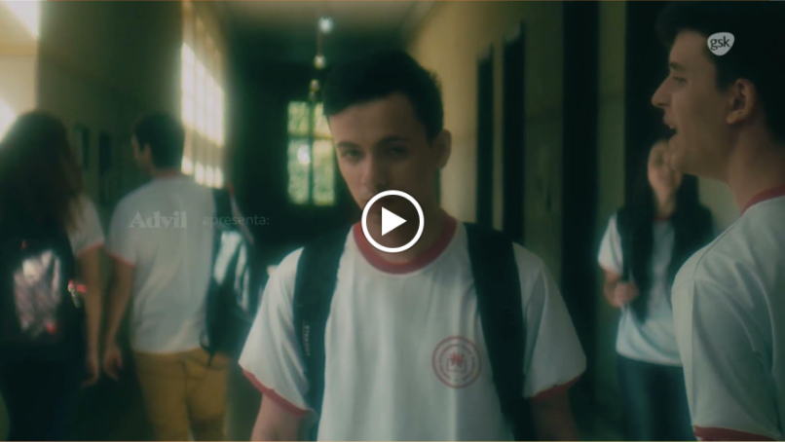


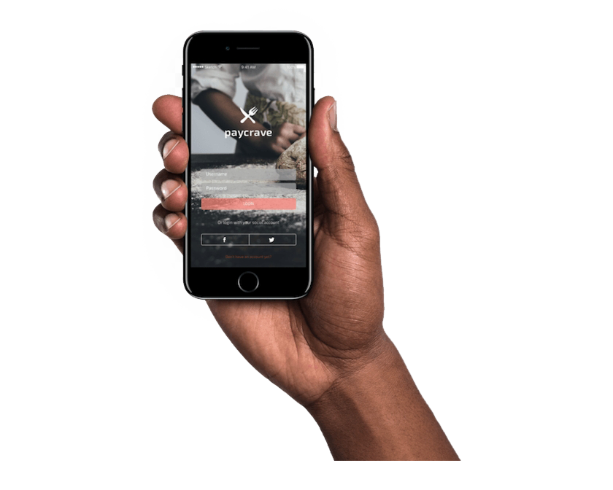
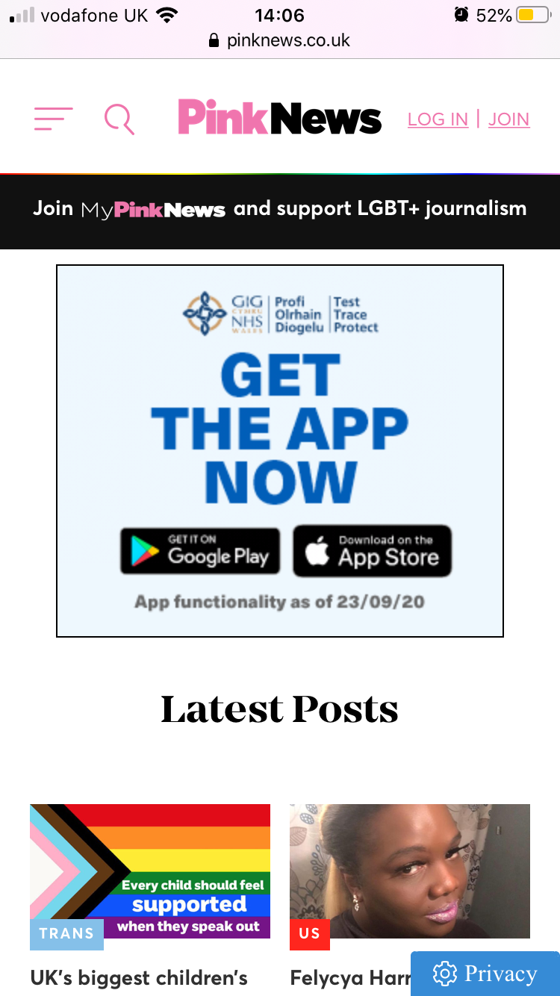
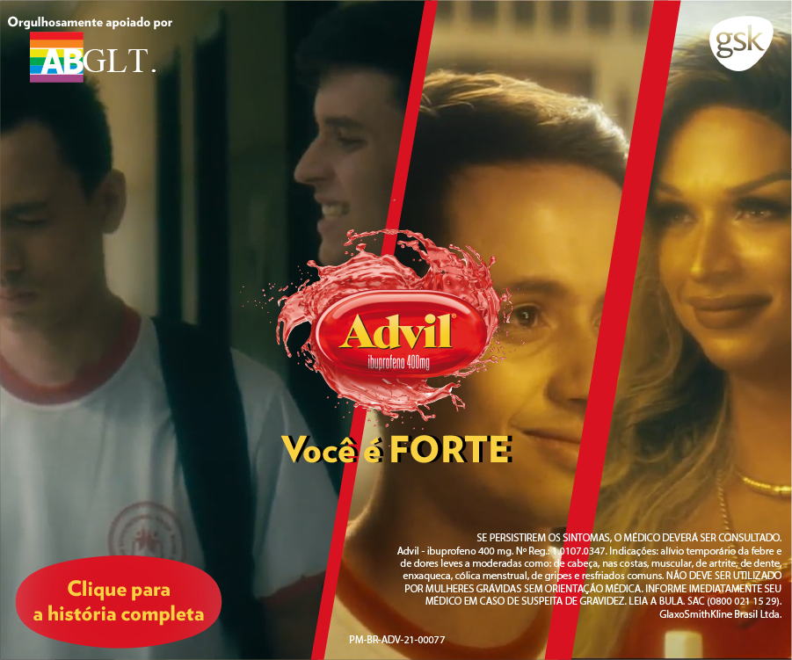
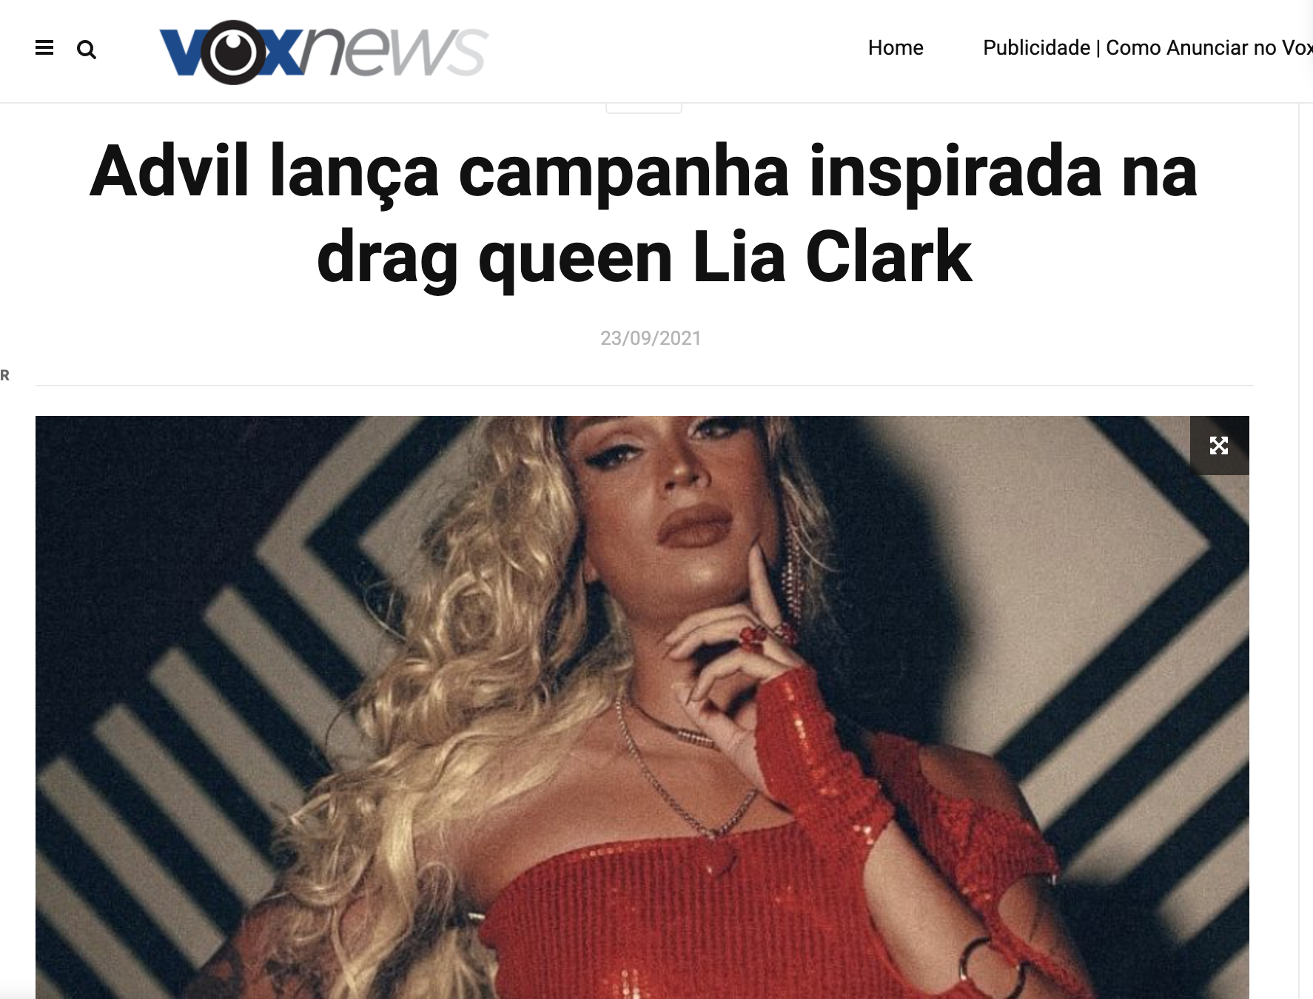


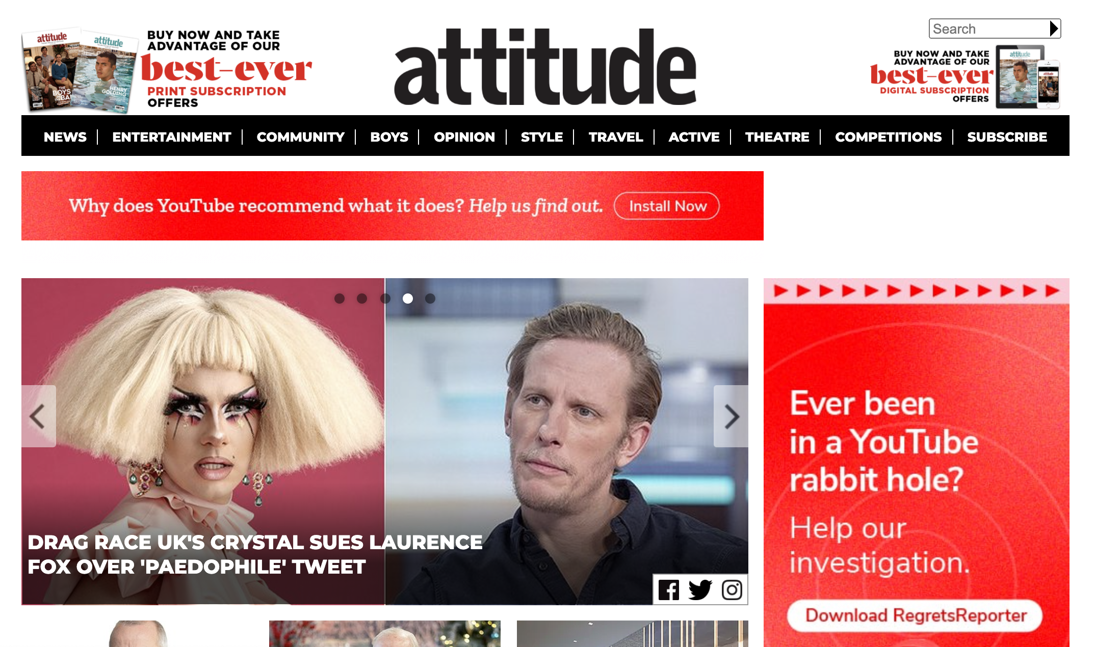
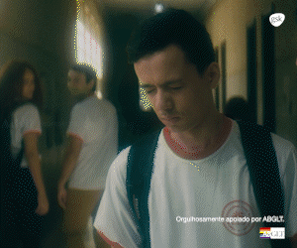
Brand Advance Group was approached by GSK to brainstorm, create and deliver a strong campaign for Advil that featured the LGBTQ+ community in Brazil.
THE RESULTS:
Video Display
VTR: 65.64% CTR: 0.23%
CTR: 0.88% View: 74.28%
View: 81.60%

Slide 6
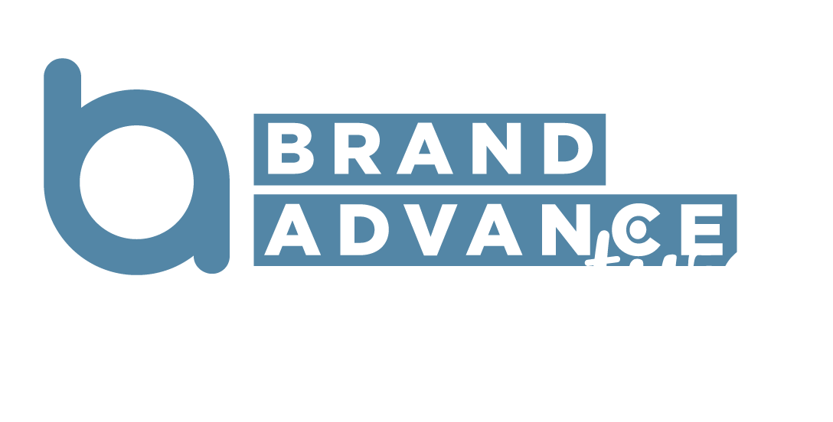
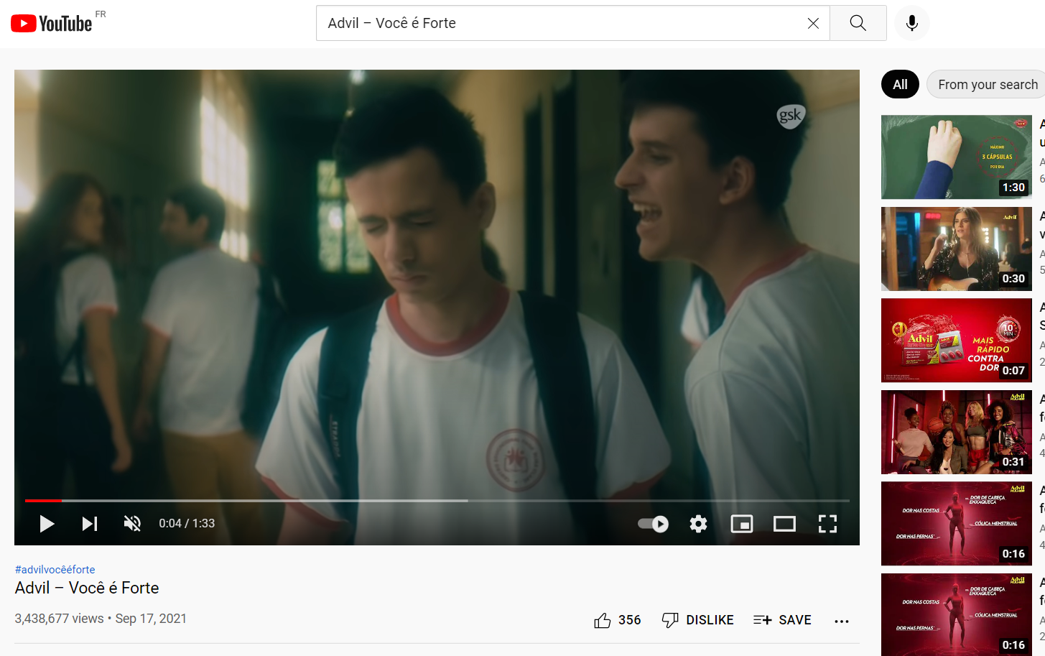
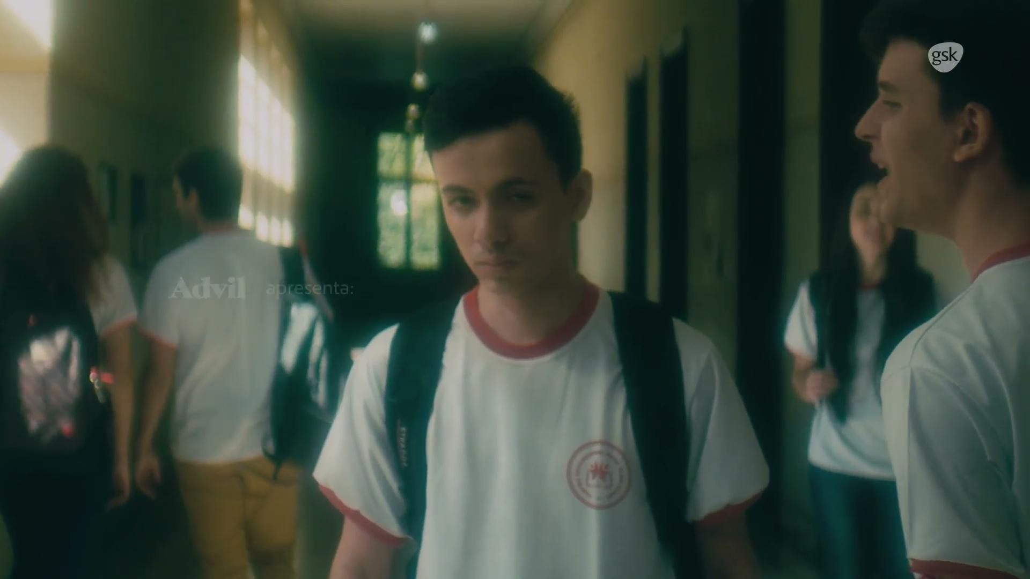
YouTube - Viral Reach
The Advil: Você é Forte video has had just under
3.5 million organic views.
Demonstrating that truly authentic creative resonates above and beyond the planned campaign.
Delivering strong attention and word of mouth performance.

Slide 7
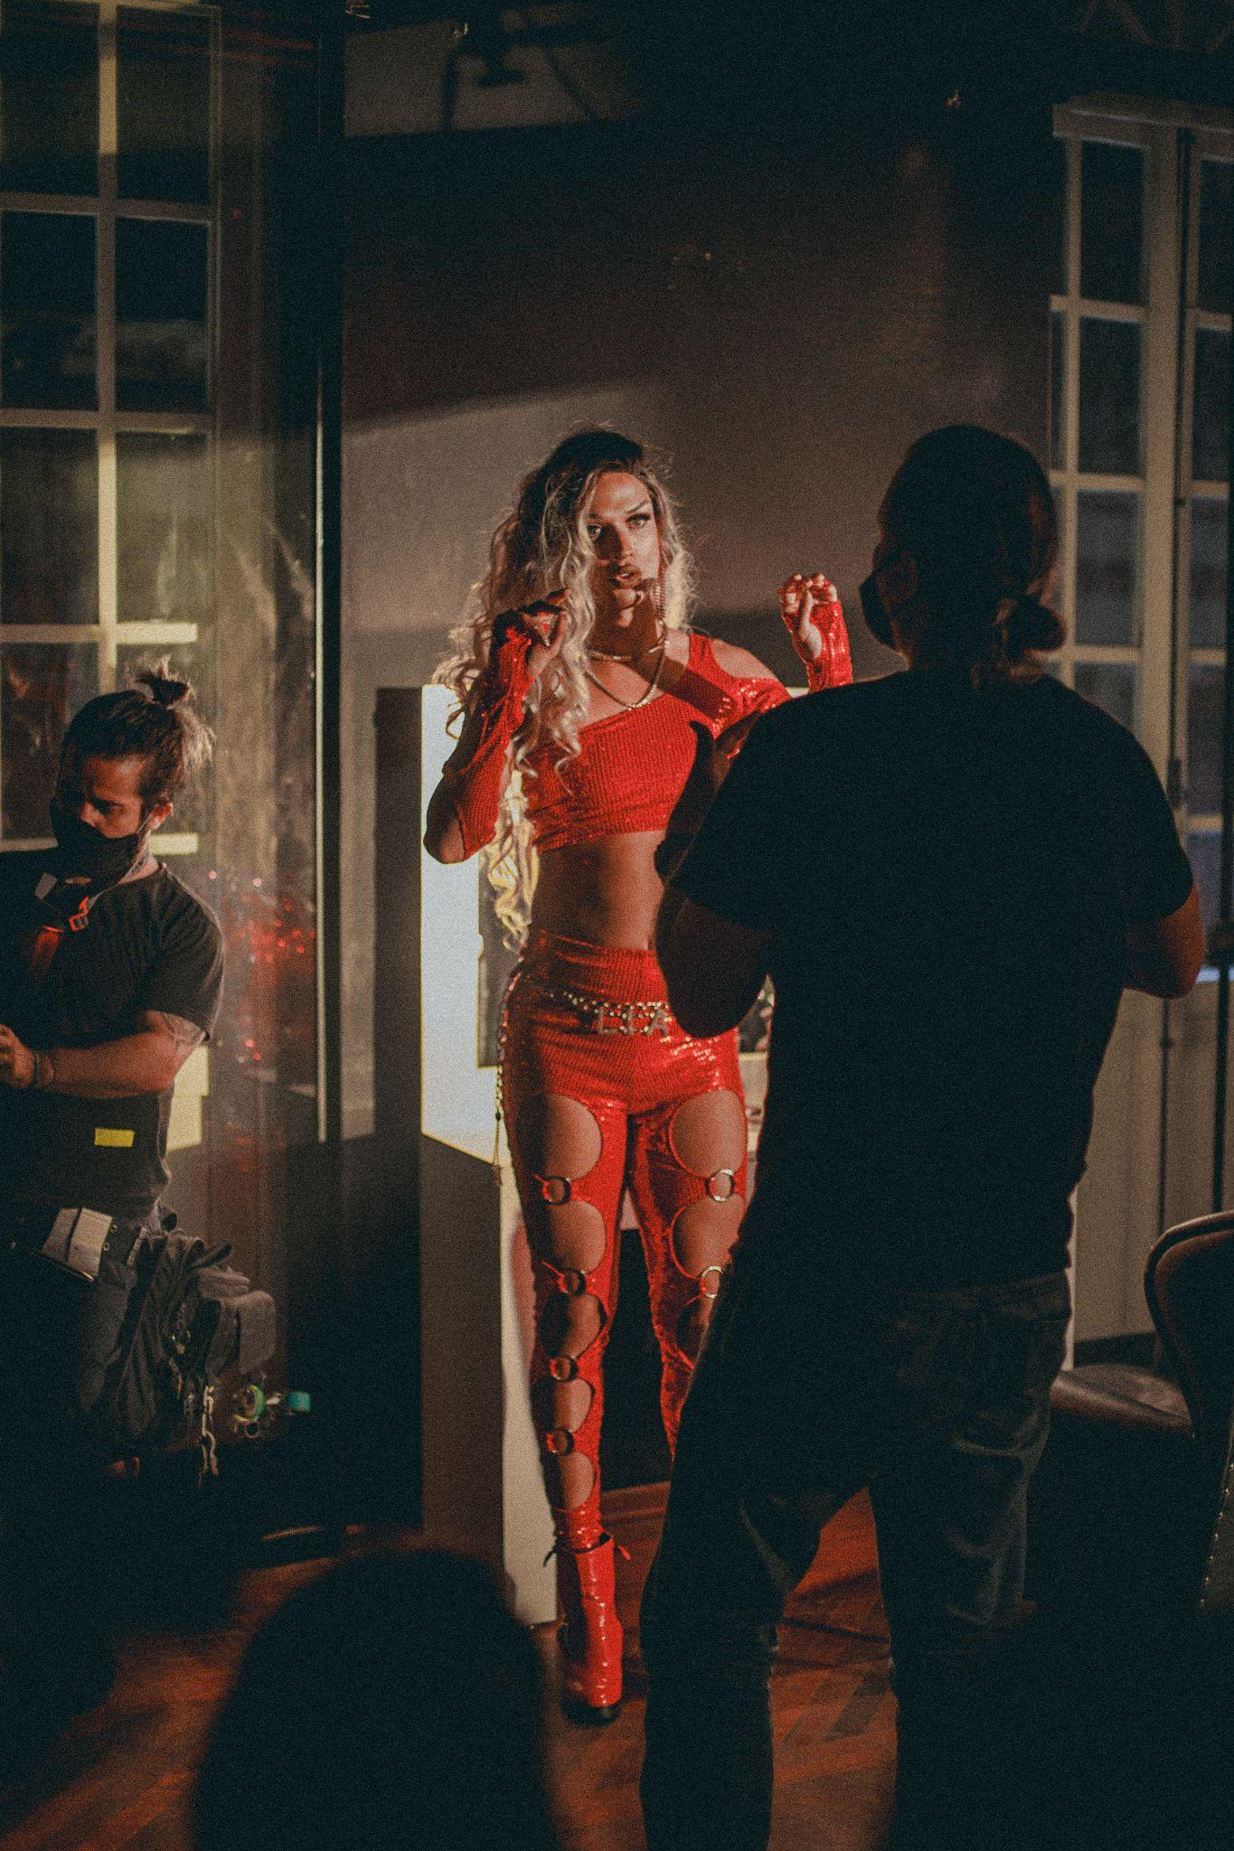
Customer Testimonial
“I wanted to praise you. I was watching Youtube and I saw the Advil campaign. I think it is a new campaign launched by you about the LGBT cause and I would like to congratulate the company for having such a beautiful position and supporting the cause. I'm not part of the LGBT group but I think the brand positioning is very important in such dark times that we are living, mainly politically, where discrimination, hate and other issues and it seems that people have become blind to inclusion.
And I am a teacher, so I work a lot with minorities, I know firsthand through the suffering of my students and what you feel when you are discriminated against for being different in any sphere. In fact, we are equal. Anyway, I would like to congratulate you, I thought the campaign was beautiful.
I'm so happy, you know. Next time when I go to the pharmacy, I'll buy Advil.
I already buy Advil but I'll look at it with affection. Even if it's a little more expensive, but I'll buy it, I liked it.”

Slide 8
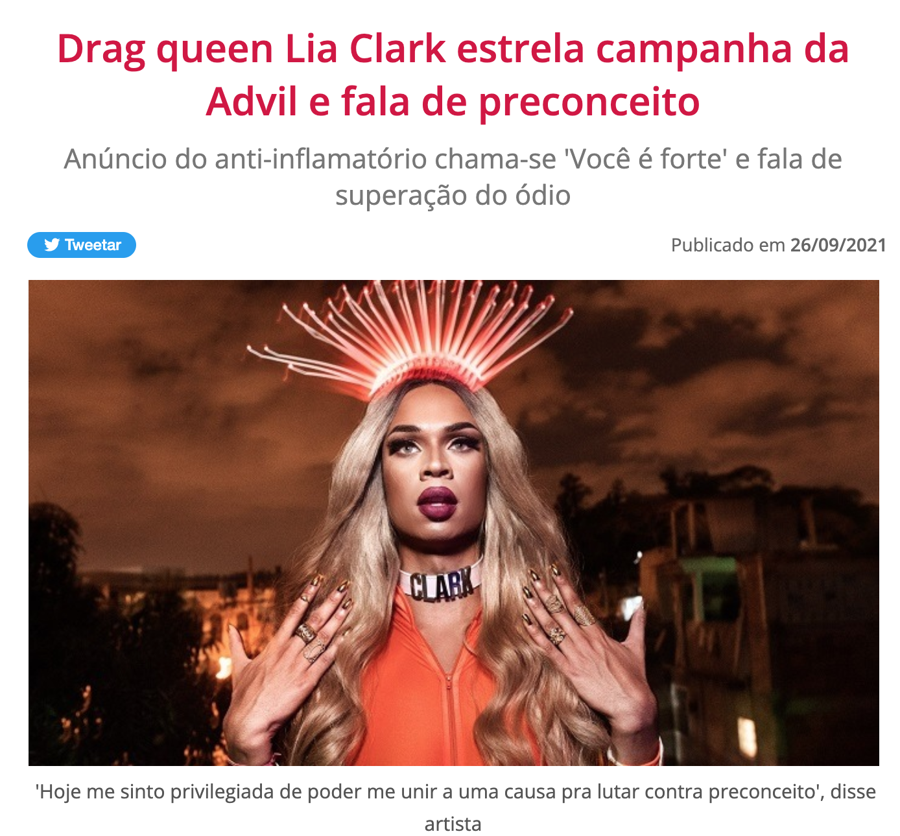
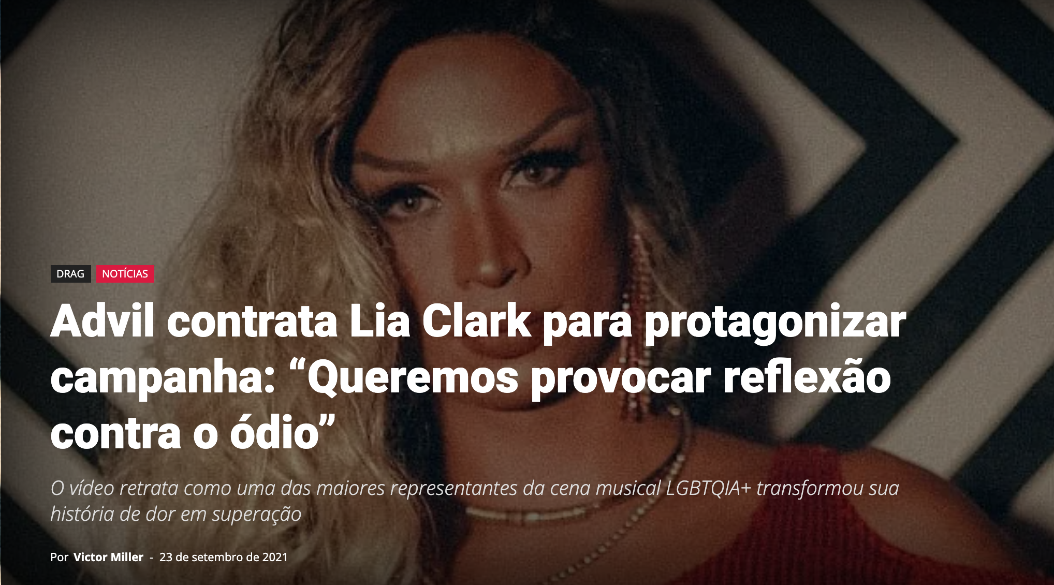
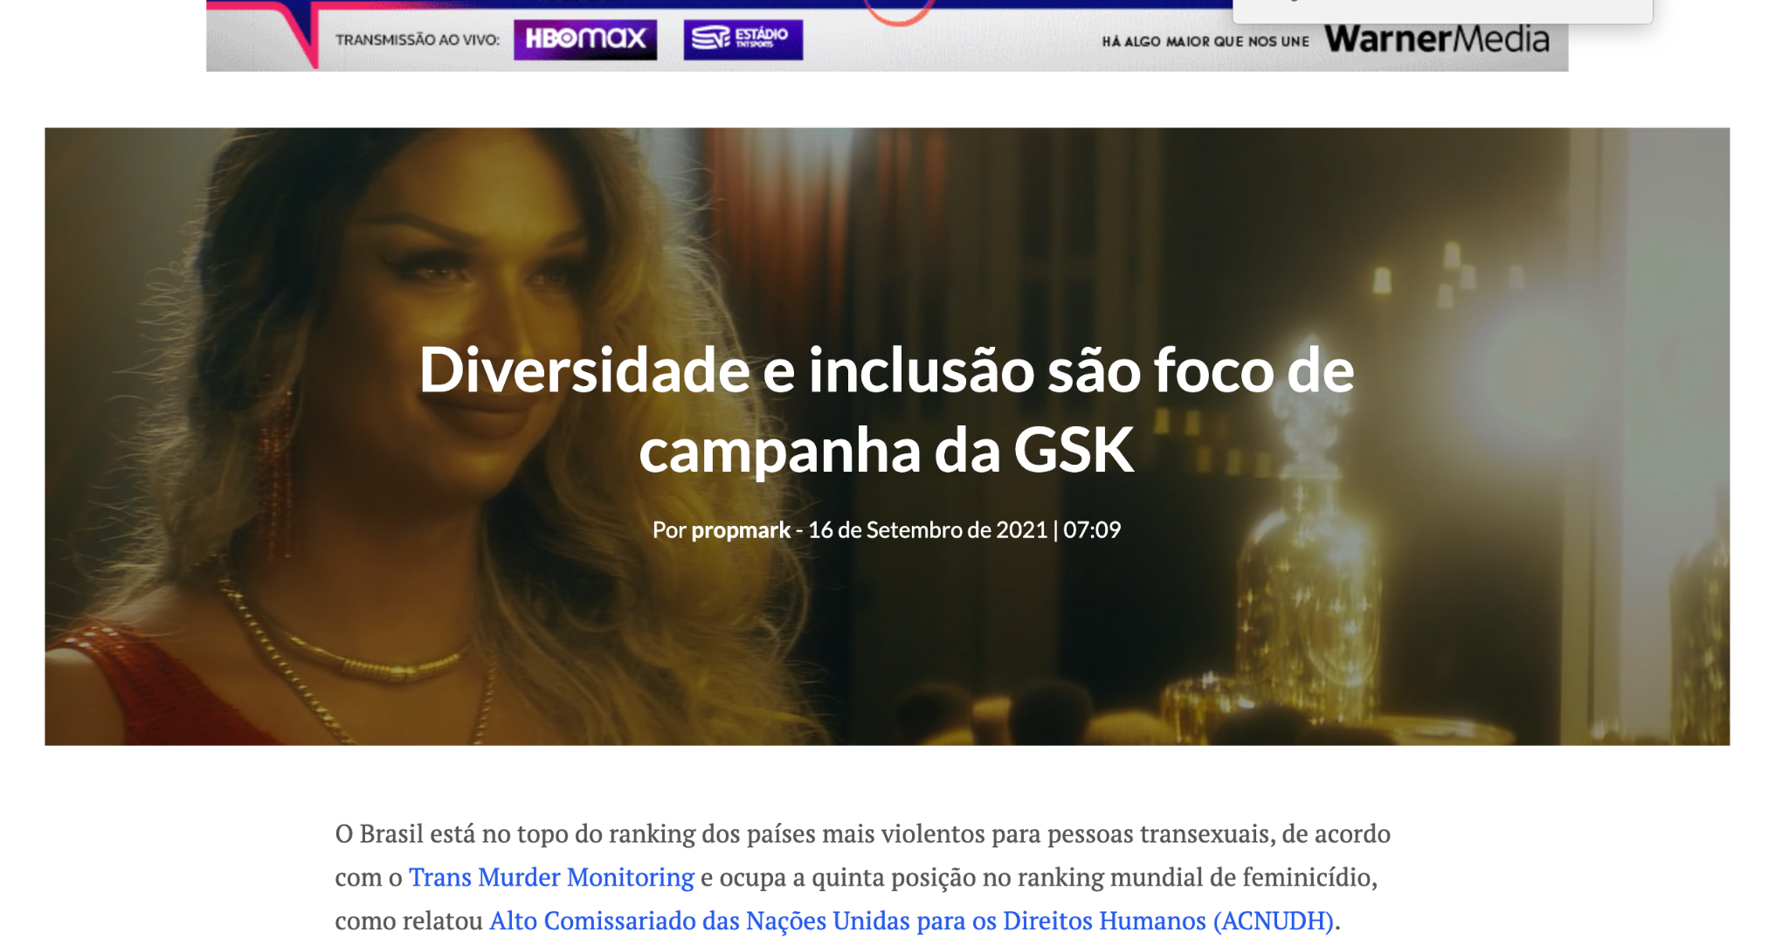
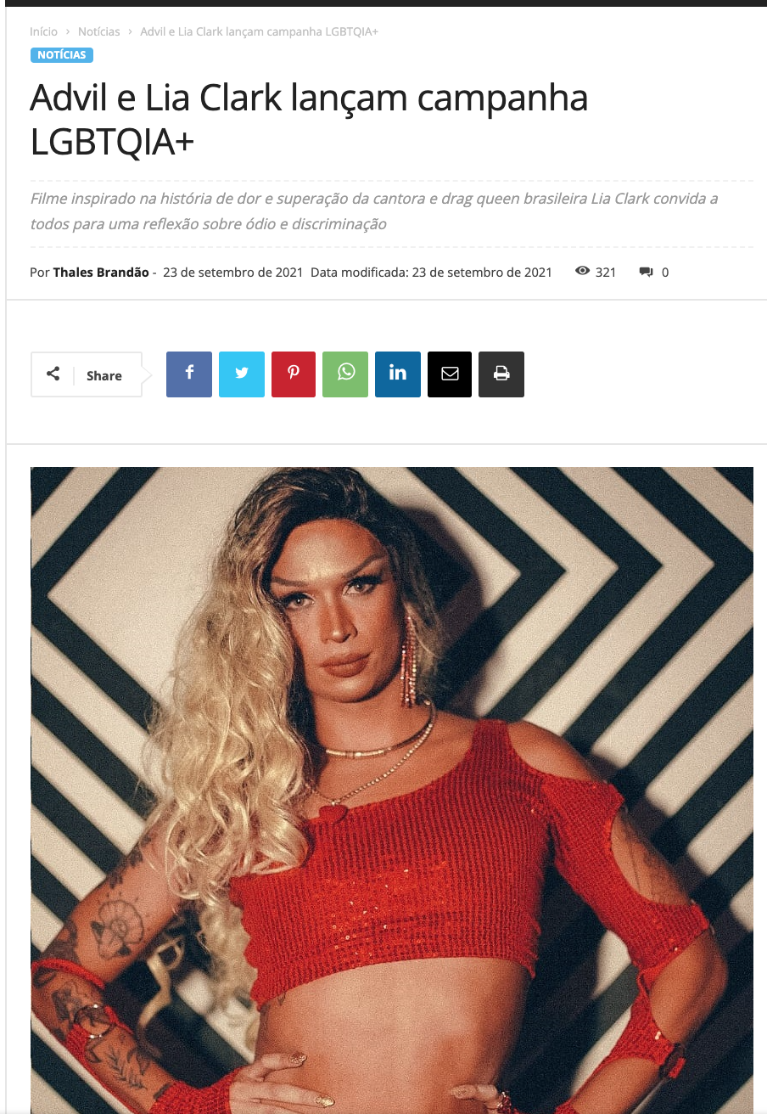
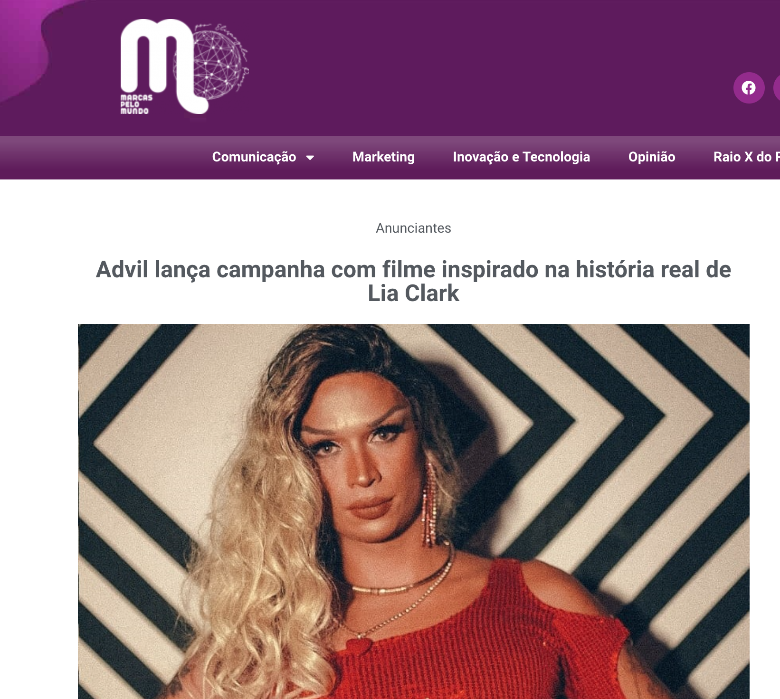
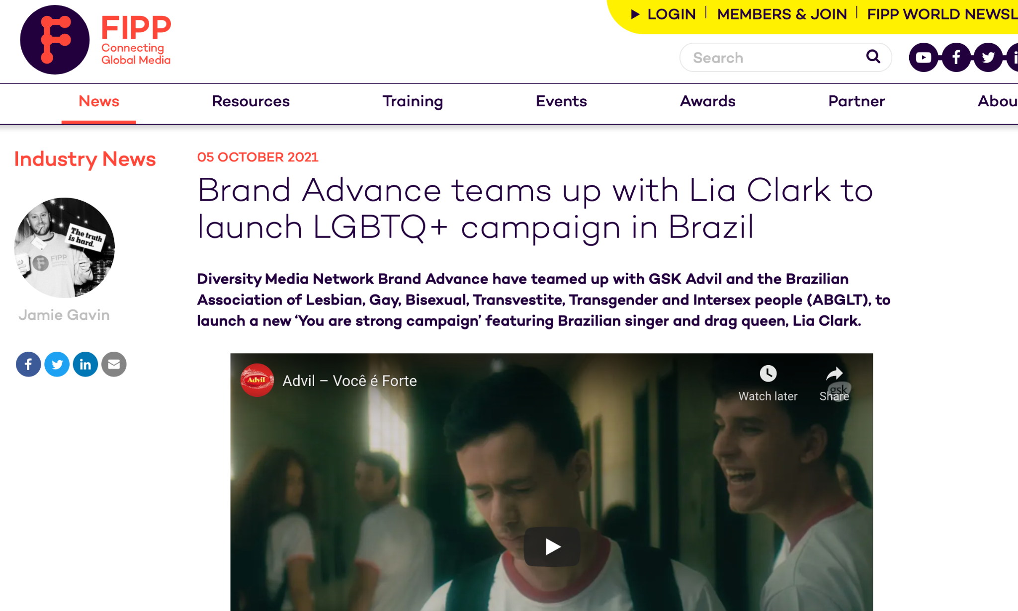
Global Press

Slide 9
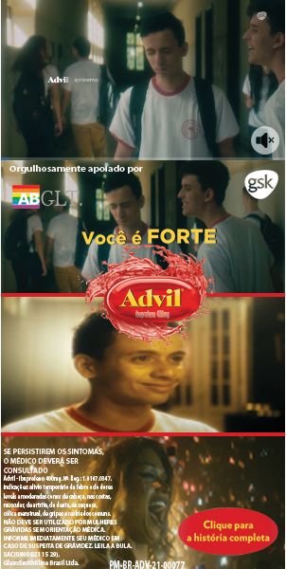
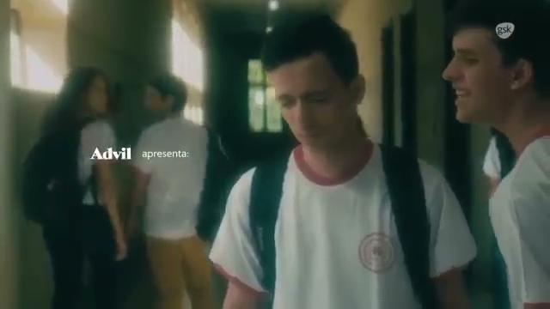

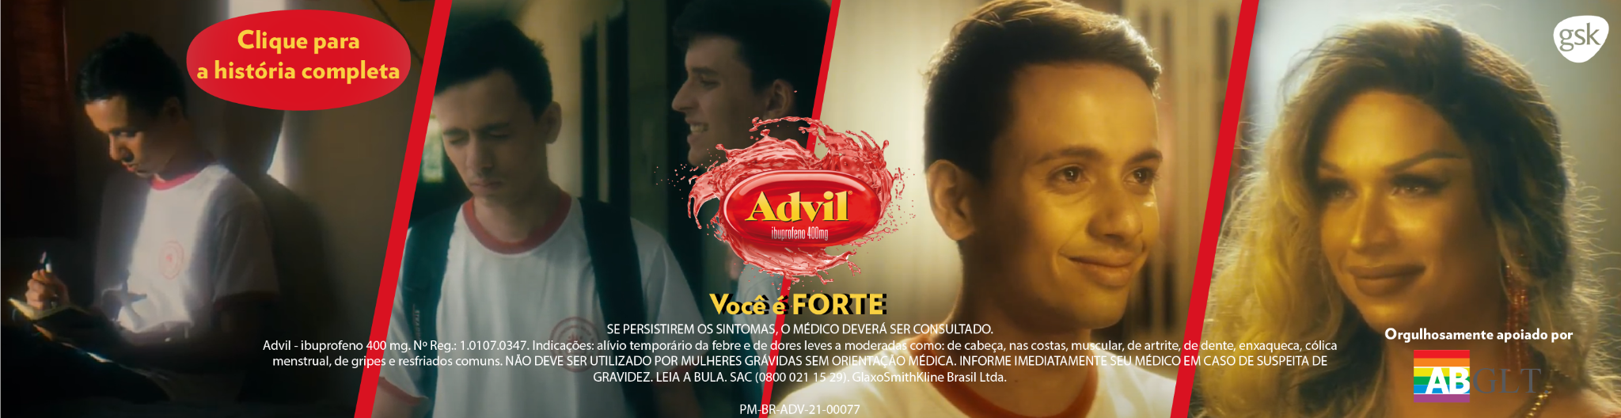
Advil - “You are Stronger”

